Slide 1
[SMM4H - Task 6]
Classification of COVID-19 tweets containing symptoms
Jeong-Woo Ko, Sereen Kallerackal,
Lyna Truong
LHS 712 Final Project
April 19, 2021
Notes:
Sereen
Really good paper we can base our report/presentation on: https://journals.plos.org/plosone/article?id=10.1371/journal.pone.0245909
Really like some of the visualizations they use for the accuracy/results

Slide 2
Background
First U.S COVID-19 Case : 19 January 2020
Constant news updates and tweets on medical symptoms/ people responses/ updates from officials, and more.
There are two main issues associated with the classification of medical symptoms from COVID-19 tweets.
Firstly, there is plenty of information on medical symptoms and it poses a difficulty of classifying and identifying important user-reported information.
Secondly, users tend to provide information that others experience, instead of their own as they are usually relatives or caregivers of the individuals having the symptoms.
So, differentiating personal COVID-19 related tweets may help to provide relevant insights, and this will help cities or states to prepare ahead and minimize the potential impact of surges or waves of cases.
Notes:
Sereen
Basic inf on Covid
Project descripiton

Slide 3



Objective
Classify personal COVID-19 related tweets to determine if they are:
self-reports
non-personal reports
literature/news mentions
Notes:
Sereen

Slide 4
Dataset: Social Media Mining for Health Applications (#SMM4H) Shared Task 2021 Challenge
Provided by the Health Language Processing Lab from the Perelman School of Medicine, University of Pennsylvania
The total dataset contains 16,067 tweets.
9,567 tweets reserved for training purposes (~60%)
6,500 tweets for testing (~40%)
For this classification task, the tweets are labeled with target classes of:
(1) self reports (15%)
(2) non-personal reports (38%), and
(3) literature/news mentions (47%).
Notes:
Lyna
The dataset we will be using for this project is provided by the Health Language Processing Lab from the Perelman School of Medicine, University of Pennsylvania as part of the Social Media Mining for Health Applications (#SMM4H) Shared Task 2021 Challenge [CITE]. The total dataset contains 16,067 tweets, with 9,567 tweets reserved for training purposes (~60%), and 6,500 tweets for testing (~40%). For this classification task, the tweets are labeled with target classes of (1) self reports, (2) non-personal reports, and (3) literature/news mentions. Approximately 15% of the tweets were self-reported, 38% were non-personal reports, and 47% were literature/new mentions.

Slide 5
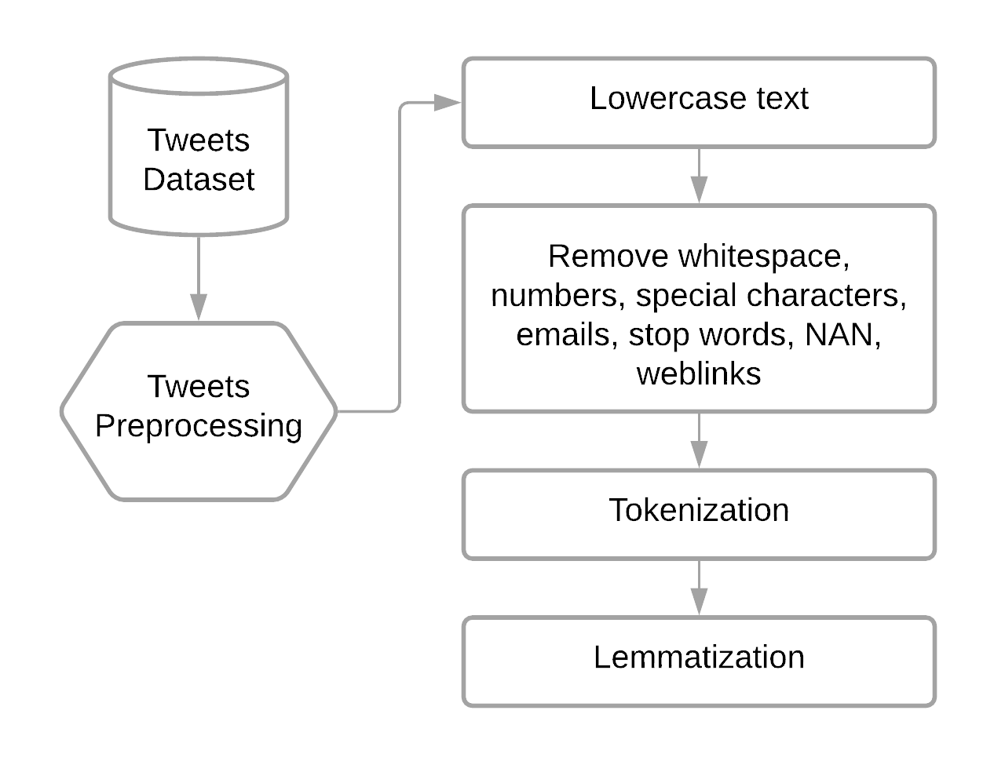
Methodology: Text Pre-Processing
Tweet Label | Original Tweet | Processed Tweet
Literature/news mentions | Medical experts advise that symptoms of the novel coronavirus include fever, shortness of breath, and stinky smelly pits and feet | medical experts advise symptoms novel coronavirus include fever shortness breath stinky smelly pits feet
Notes:
Lyna
This is a flowchart of our text-preprocessing methodology. Preprocessing is an important step, which affects accuracy of learning models. We first converted all words to lowercase, and removed any whitespace, numbers, special characters, emails, stop words, null characters, and weblinks using regular expressions to reduce the noise in our dataset. All tweets were tokenized, and then underwent lemmatization to convert the word to its meaningful base form to further reduce the dimensionality of our dataset.
Stop Words: To reduce the dimensionality of the tokens, we removed all stop words. Tokenization: All tweets were broken up into words called tokens.
Lemmatization: I further tried to reduce the dimensionality of the tokens through word stemming/lemmatization to reduce the inflectional forms of each word into a common base or root.

Slide 6
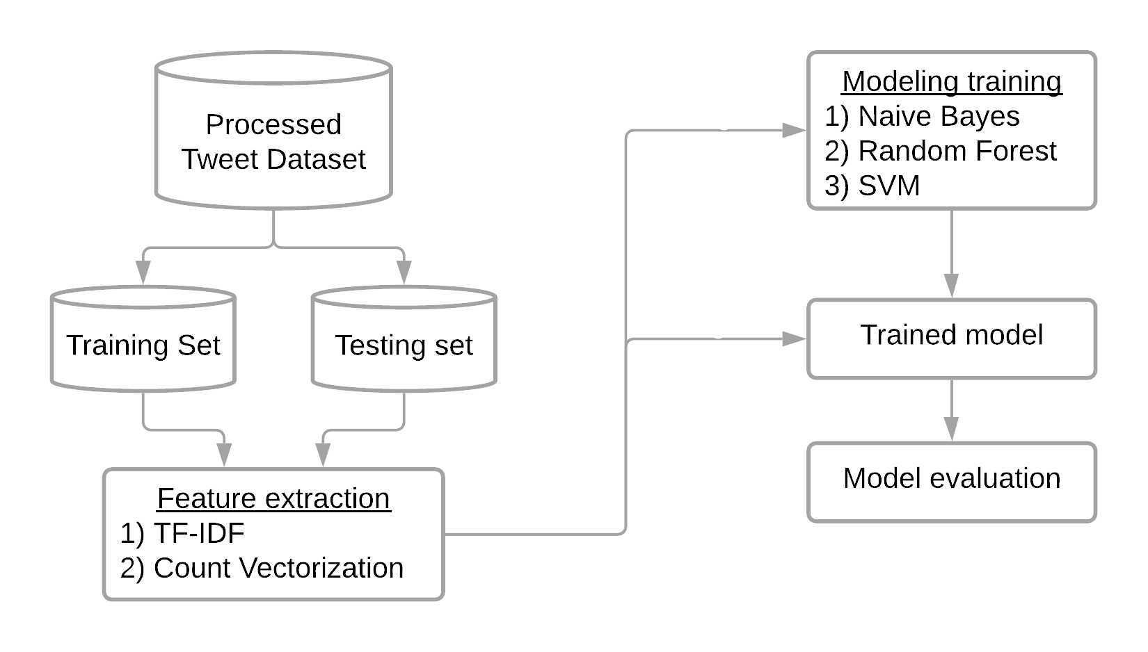
Methodology: Modeling
Notes:
Lyna
A flowchart of our modeling methodology is shown in Figure 3. The processed dataset was split into a training and test dataset (as specified by the challenge), and then both datasets went through a feature extraction process. For our analysis, we focused on two feature extraction techniques: TF-IDF and count vectorization. Each training set was used to train three models: naive Bayes, random forest, and support vector machine (SVM). After training the models, each test set was applied to the training model to predict the tweet classification. For the SVM model, we did do some hyperparameter tuning to find the best combination of hyperparameters that produced the model with the highest accuracy. Model performance was evaluated on the accuracy, precision, recall, and F1 score.

Slide 7
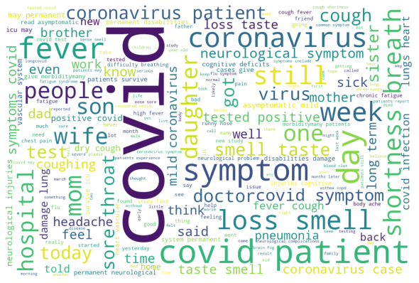
Notes:
Jeong-woo
Lyna verified: the wordcloud function generates n-grams among all of the tweets, and shows the most common words/phrases.

Slide 8
Results w/ TF-IDF
Model | Weighted Accuracy | Class | Precision | Recall | F1 score
Naive Bayes | 0.92 | Lit/news | 0.96 | 0.97 | 0.97
 |  | Non personal | 0.86 | 0.96 | 0.90
 |  | Self reports | 0.94 | 0.64 | 0.76
Random Forest | 0.95 | Lit/news | 0.96 | 0.99 | 0.97
 |  | Non personal | 0.92 | 0.94 | 0.93
 |  | Self reports | 0.95 | 0.82 | 0.88
SVM | 0.97 | Lit/news | 0.97 | 0.99 | 0.98
 |  | Non personal | 0.97 | 0.94 | 0.96
 |  | Self reports | 0.95 | 0.95 | 0.95
Notes:
Jeong-woo

Slide 9
Results w/ Count Vectorization
Model | Weighted Accuracy | Class | Precision | Recall | F1 score
Naive Bayes | 0.94 | Lit/news | 0.97 | 0.98 | 0.98
 |  | Non personal | 0.90 | 0.95 | 0.92
 |  | Self reports | 0.93 | 0.78 | 0.85
Random Forest | 0.93 | Lit/news | 0.96 | 1.00 | 0.98
 |  | Non personal | 0.89 | 0.94 | 0.91
 |  | Self reports | 0.98 | 0.68 | 0.81
SVM | 0.97 | Lit/news | 0.97 | 0.99 | 0.98
 |  | Non personal | 0.97 | 0.94 | 0.96
 |  | Self reports | 0.96 | 0.96 | 0.96
Notes:
Jeong-woo

Slide 10
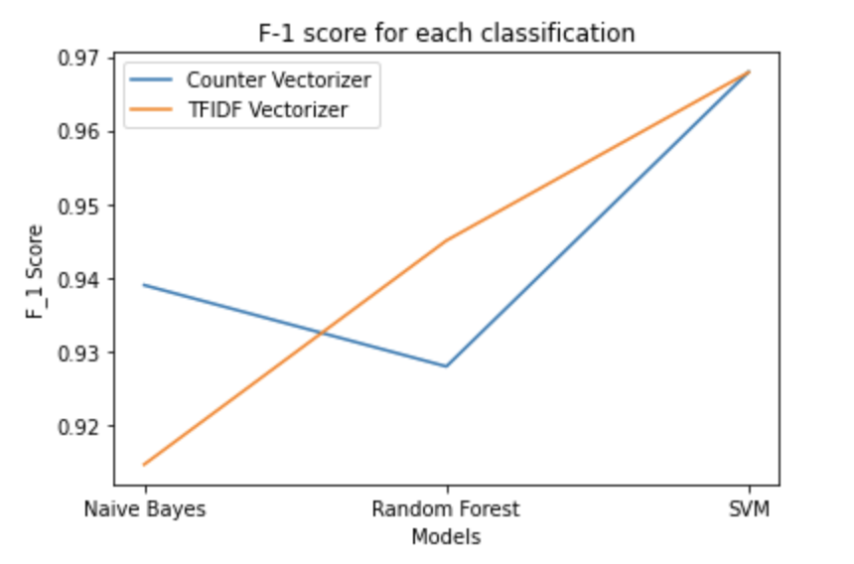
F1 Score Graph
Notes:
Jeong-Woo (if we have time)

Slide 11
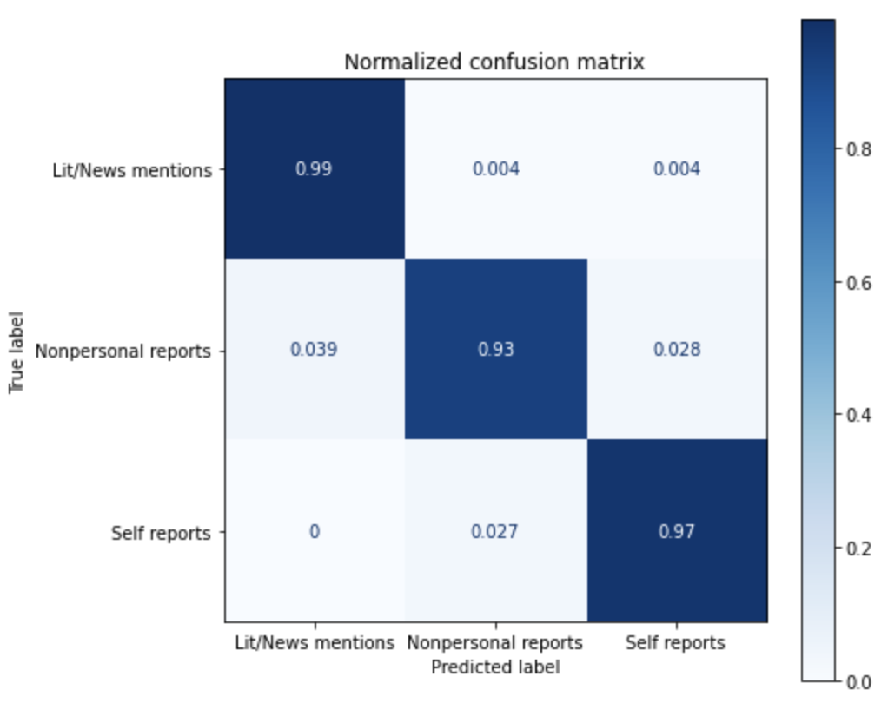
Confusion Matrix of SVM Model w/ Count Vect.
Notes:
Jeong-woo

Slide 12
Limitations
Analysis was limited to only SVM, Naive Bayes and Random Forest. Trying other models could have improved our final scores.
Only focused on 2 types of feature engineering (TF-IDF and Count Vectorization). The results may be different or better if we tried other kinds.
The word ‘I’ and other pronouns could possibly be indicative of the self-reported/non-personal class, but we deleted all the words under length of 2.
Notes:
Sereen

Slide 13
Conclusions
Best performing model: SVM model with Count vectorization
Highest weighted accuracy score (0.97)
Based on our analysis, we do believe that it is possible to classify these tweets into the three categories (Lit/news mentions, Non-personal reports, Self reports)
For future, we might have to consider changing some of the pre-processing steps.
Notes:
Sereen

Slide 14
Questions?

